Slide 1
Normalization: Aurora 1

Slide 2
Today's Objectives
By the end of this lesson, you will be able to:
Explain the purpose of database normalization
Describe the characteristics of First, Second, and Third Normal Form
Identify repeating groups, partial dependencies, and transitive dependencies
Apply normalization rules to transform unnormalized data into 3NF
Explain how business rules affect database design
Create normalized database schemas from business scenarios
Evaluate normalization and denormalization tradeoffs
Merge multiple views into a consolidated ERD

Slide 3
Where Are We in the Course?
Review from Day 5 →
Normal Form | Rule | Violation | Fix
1NF | Atomic attributes, no repeating groups | Repeating group | Move to new table, copy PK as FK
2NF | All non-key attributes fully depend on entire PK | Partial dependency | Move to new table, copy PK part as FK
3NF | No non-key attribute depends on another non-key attribute | Transitive dependency | Move to new table, copy non-key attribute as PK/FK

Slide 4
The Normalization Process
How do we normalize a database?
Collect views (subsets of data) using source documents and business rules.
Apply the rules of 1NF, 2NF, and 3NF to produce a schema.
Repeat for each view.
Merge all schemas into a single logical design.
  Tables with the same PK can be merged.
  All entities, attributes, and relationships must be preserved.
Today we will work through Aurora Views 1 and 2, then merge them.

Slide 5
Aurora — A New Scenario
Meet Aurora — a company that needs a database.
Today we will work with two views:
View | Description
Aurora View 1 | Employee and Department information
Aurora View 2 | Project and Assignment information

Slide 6
Aurora — A New Scenario
Concept | Details
Entities | Employee, Department, Project
Relationships | Employee : Department (N:1)
 | Department : Project (1:N)
 | Employee : Project (N:M)
Candidate Keys | Employee ID, Department Number, Project Number
Our Goal:
Normalize each view to 3NF, then merge them into a single ERD.
Before we start, let's identify→

Slide 7
Aurora View 1 — Business Rules
Business Rules:
An employee works for a single department.
A department can have many employees working for it simultaneously.
A single department develops a project.
A department can develop many projects simultaneously.
An employee can be assigned to a maximum of 4 projects simultaneously.
A project can have many employees working on it simultaneously.
Employee ID, Department Number, and Project Number uniquely identify employees, departments, and projects respectively.

Slide 8
Aurora View 1 — Business Rules
What are the entities?
Employee, Department, Project
What are the relationships?
Employee : Department (N:1)
Department : Project (1:N)
Employee : Project (N:M)

Slide 9
Aurora View 1 — Initial Table (0NF)
Step 0: Create the Initial Table
List all data items. Identify the PK. Mark repeating groups in parentheses.
Initial Table:
Employee(Employee ID, Name, Department Number, Department Name,
(Project Number, Project Name, Sponsoring Department Name, Weekly Hours))
Notation:
Symbol | Meaning
Underline | Primary Key
( ) | Repeating Group

Slide 10
Aurora View 1 — Initial Table (0NF)
Which is the PK?
Employee ID — because each row describes one employee.
Why not Department Number or Project Number?
A department can have many employees, so it doesn't uniquely identify a row.
A project can have many employees, so it doesn't uniquely identify a row.

Slide 11
Aurora View 1 — 1NF Rules
1NF has two rules:
Violations in Aurora View 1:
Rule | Description
1 | A table MUST contain atomic attributes
2 | A table cannot contain any repeating groups of attributes
Violation | Type
Name | Composite attribute (should be FirstName, LastName)
Project Number, Project Name, Sponsoring Dept Name, Weekly Hours | Repeating group

Slide 12
Aurora View 1 — 1NF Rules
How to fix:
If a repeating group exists:
Remove the repeating group from the original table
Place them in a new table
Duplicate the primary key of the original table and place in the new table as a foreign key
Designate the cardinality of the relationship
Designate a primary key for the new table
If composite attributes exist:
Replace with two or more atomic attributes

Slide 13
Aurora View 1 — 1NF Result
Fixes applied:
1NF Tables:
Original | Fixed
Name | LastName, FirstName
Repeating Group | New table: WorksOn
Employee(Employee ID, LastName, FirstName, Department Number, Department Name)
WorksOn(Employee ID (FK), Project Number, Project Name, Sponsoring Department Name, Weekly Hours)

Slide 14
Aurora View 1 — 1NF Result
Determining the PK for WorksOn:
Candidate Key | Can It Uniquely Identify a Row? | Why?
Employee ID | No | One employee can work on multiple projects
Project Number | No | One project can have multiple employees
Employee ID + Project Number | Yes | The combination is unique
Primary Key for WorksOn: Employee ID + Project Number (Composite Key)

Slide 15
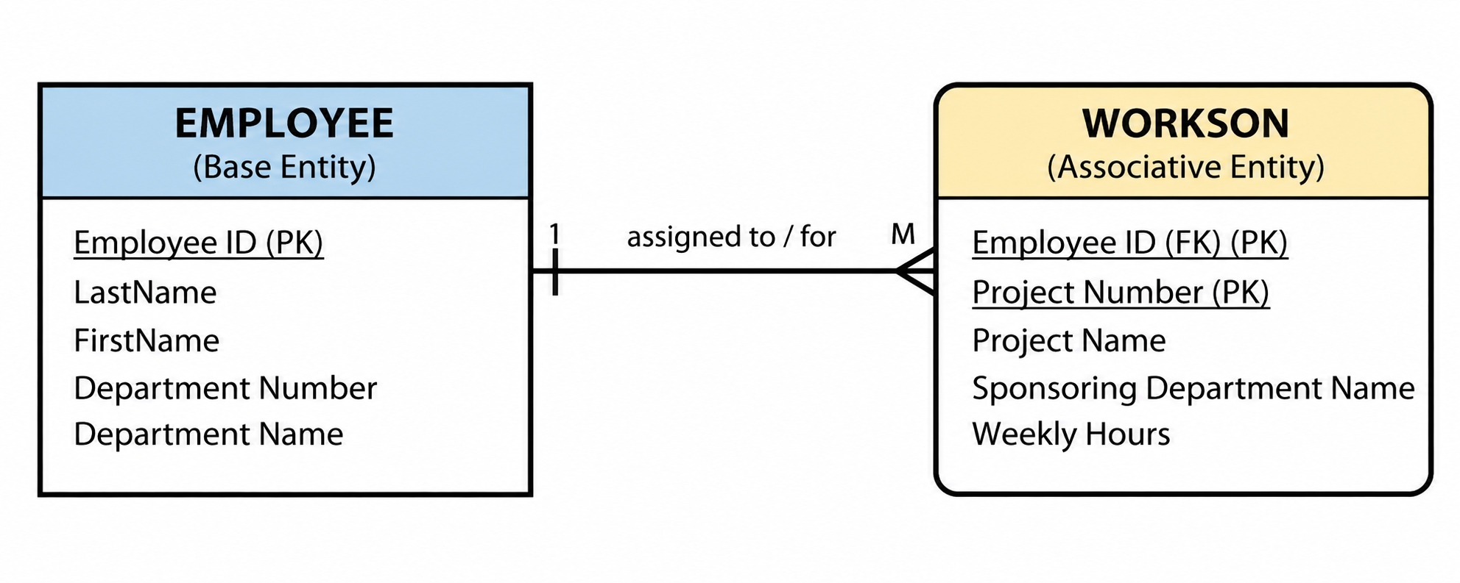
Aurora View 1 — 1NF ERD
Relationship: Employee (1) → WorksOn (M)
The schema is now in First Normal Form (1NF).

Slide 16
Aurora View 1 — 2NF Rules
2NF has one rule:
All non-key attributes in a table must fully depend on the entire primary key of the table.
Key Point:
A violation to 2NF can ONLY occur in a table with a composite primary key.
Our tables→
Table | Primary Key | Can 2NF Be Violated?
Employee | Employee ID (single) | No — automatically in 2NF
WorksOn | Employee ID + Project Number (composite) | Yes — must evaluate

Slide 17
Aurora View 1 — 2NF Rules
What does "fully depend" mean?
A non-key attribute is fully dependent on a primary key attribute if: For each value of the key attribute, there can be only one value for the non-key attribute.
In other words: If you know the value of the key attribute, you know the value of the non-key attribute.
Table | Primary Key | Can 2NF Be Violated?
Employee | Employee ID (single) | No — automatically in 2NF
WorksOn | Employee ID + Project Number (composite) | Yes — must evaluate

Slide 18
Aurora View 1 — 2NF Violations
Evaluate WorksOn for partial dependencies:
Attribute | Fully Dependent on Employee ID? | Fully Dependent on Project Number? | Fully Dependent on Both?
Project Name | No | Yes | —
Sponsoring Department Name | No | Yes | —
Weekly Hours | No | No

Slide 19
Aurora View 1 — 2NF Violations
Violations Found:
Attribute | Violation | Depends On
Project Name | Partial Dependency | Project Number
Sponsoring Department Name | Partial Dependency | Project Number
Weekly Hours is fully dependent on both Employee ID and Project Number — it complies with 2NF.

Slide 20
Aurora View 1 — 2NF Result
How to fix a partial dependency:
Remove the partially dependent attribute(s) from the original table
Place in a new table
Duplicate the primary key attribute(s) they are dependent on and place in the new table
The duplicated attribute(s) become foreign keys in the original table
Designate the cardinality of the relationship
Designate a primary key for the new table

Slide 21
Aurora View 1 — 2NF Result
Fixes applied:
2NF Tables:
Attribute | New Table | New PK
Project Name | Project | Project Number
Sponsoring Department Name | Project | Project Number
Employee(Employee ID, LastName, FirstName, Department Number, Department Name)
WorksOn(Employee ID (FK), Project Number (FK), Weekly Hours)
Project(Project Number, Project Name, Sponsoring Department Name)
Note: WorksOn is now an associative entity — the M:N relationship between Employee and Project is fully implemented as two 1:M relationships.

Slide 22
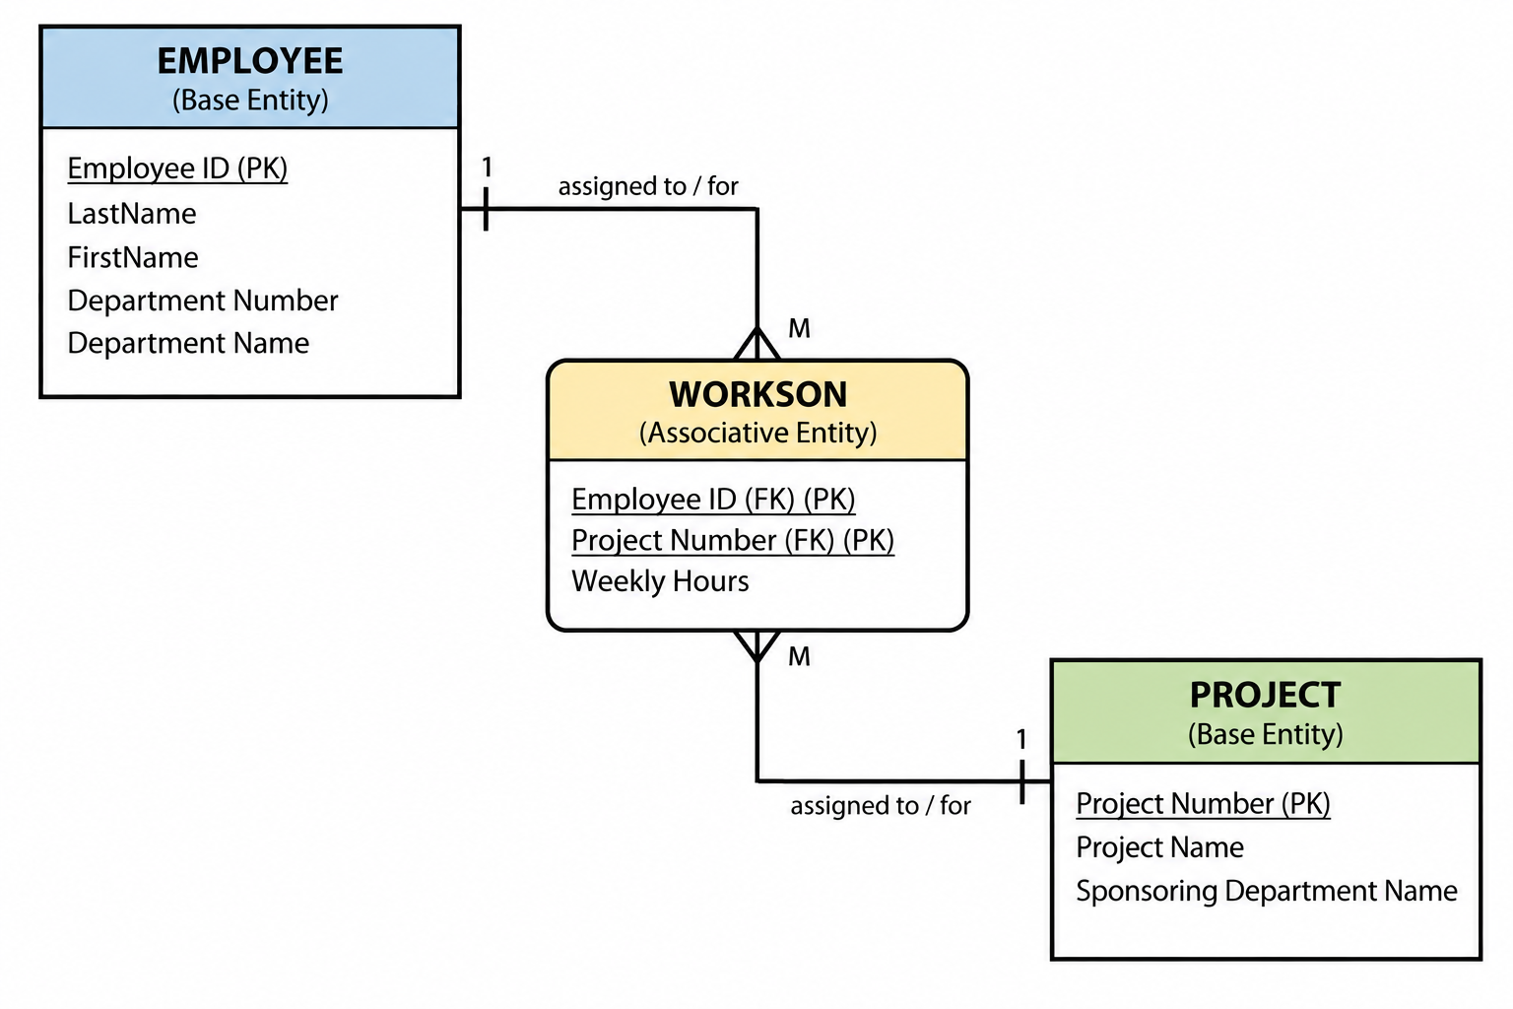
Aurora View 1 2NF ERD

Slide 23
Aurora View 1 — 3NF Rules
3NF has one rule:
A non-key attribute cannot be fully dependent on another non-key attribute.
Key Point:
A table must have two or more non-key attributes for a violation to 3NF to occur.
A non-key attribute that is fully dependent on another non-key attribute is called a TRANSITIVE DEPENDENCY.
Our tables→
Table | Non-Key Attributes | Can 3NF Be Violated?
Employee | LastName, FirstName, Department Number, Department Name | Yes — Department Name depends on Department Number
WorksOn | Weekly Hours | No — only one non-key attribute
Project | Project Name, Sponsoring Department Name | No — no dependency between them

Slide 24
Aurora View 1 — 3NF Violation
Evaluate Employee for transitive dependencies:
Non-Key Attribute | Depends On | Is This a Violation?
LastName | Employee ID | No (depends on PK)
FirstName | Employee ID | No (depends on PK)
Department Number | Employee ID | No (depends on PK)
Department Name | Department Number | Yes — transitive dependency!

Slide 25
Aurora View 1 — 3NF Violation
Why is this a violation?
Department Name is fully dependent on Department Number, which is a non-key attribute.
If you know the Department Number, you know the Department Name — without needing to know the Employee ID.
Non-Key Attribute | Depends On | Is This a Violation?
LastName | Employee ID | No (depends on PK)
FirstName | Employee ID | No (depends on PK)
Department Number | Employee ID | No (depends on PK)
Department Name | Department Number | Yes — transitive dependency!

Slide 26
Aurora View 1 — 3NF Result
3NF Tables:
Employee(Employee ID, LastName, FirstName, Department Number (FK))
Department(Department Number, Department Name)
WorksOn(Employee ID (FK), Project Number (FK), Weekly Hours)
Project(Project Number, Project Name, Sponsoring Department Name)
The schema is now in Third Normal Form (3NF).
Fixes applied:
Attribute | New Table | New PK
Department Name | Department | Department Number

Slide 27
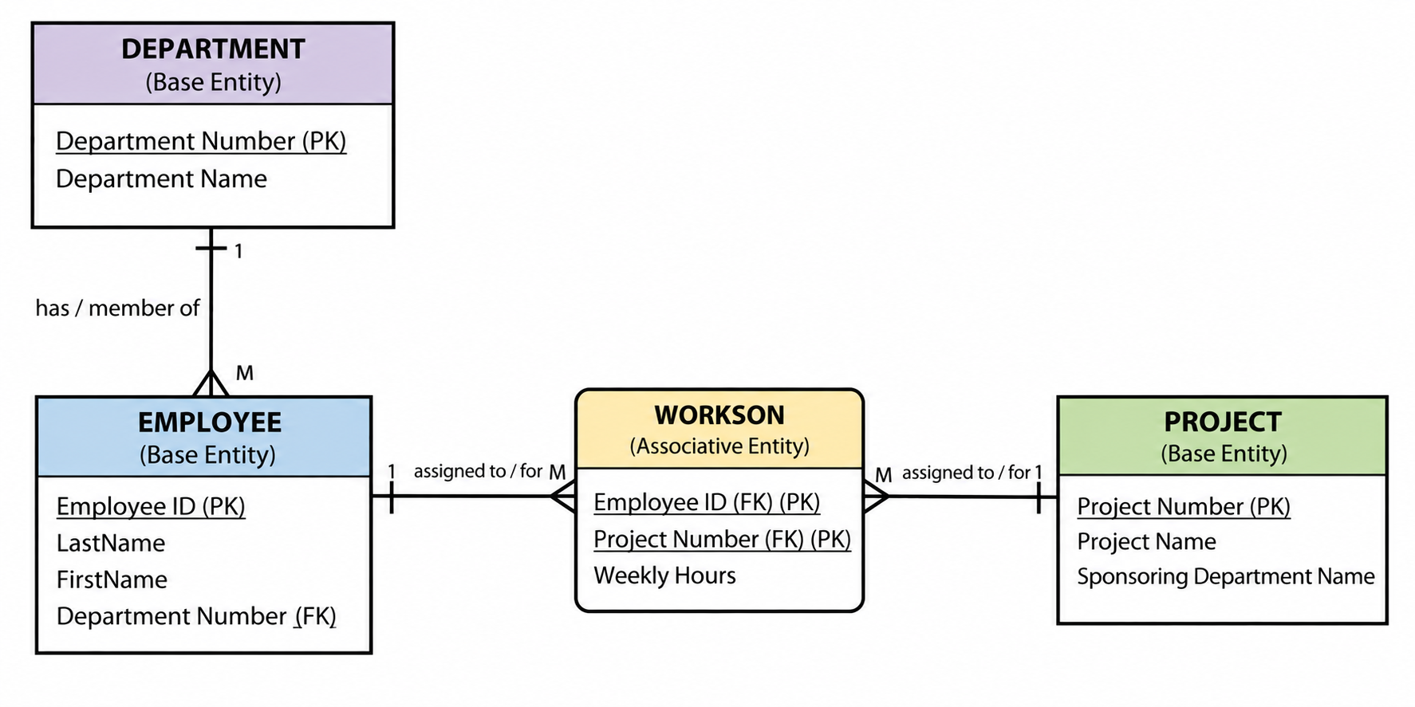
Aurora View 1 — 3NF ERD

Slide 28
Aurora View 2 — Source Document
Business Rules:
A project is developed by one department.
A department can develop many projects.
A project can have many employees assigned.
An employee can be assigned to many projects.
Each assignment has a weekly hours value.
Aurora View 2: Project Details
A manager needs to see:
Project information
Which department sponsors each project
Which employees are assigned to each project

Slide 29
Aurora View 2 — Initial Table (0NF)
Step 0: Create the Initial Table
Initial Table:
Project(Project Number, Project Name, Department Number, Department Name,
(Employee ID, Last Name, First Name, Weekly Hours))
Candidate Keys: Project Number, Department Number, Employee ID
Which is the PK?
Project Number — because each row describes one project.
Repeating Group: (Employee ID, Last Name, First Name, Weekly Hours)

Slide 30
Aurora View 2 — 1NF
Fixes:
1NF Violations:
Original | Fixed
Employee Name | LastName, FirstName
Repeating Group | New table: Assignment
Violation | Type
Employee Name | Composite attribute
Employee ID, Last Name, First Name, Weekly Hours | Repeating group

Slide 31
Aurora View 2 — 1NF
1NF Result:
Project(Project Number, Project Name, Department Number, Department Name)
Assignment(Project Number (FK), Employee ID, Last Name, First Name, Weekly Hours)
PK for Assignment: Project Number + Employee ID (Composite Key)
Fixes:
Original | Fixed
Employee Name | LastName, FirstName
Repeating Group | New table: Assignment

Slide 32
Aurora View 2 — 2NF
Evaluate Assignment (composite PK):
Violations Found:
Fix: Move Last Name and First Name to a new Employee table.
Attribute | Fully Dependent on Project Number? | Fully Dependent on Employee ID? | Fully Dependent on Both?
Last Name | No | Yes | —
First Name | No | Yes | —
Weekly Hours | No | No | Yes
Attribute | Violation | Depends On
Last Name | Partial Dependency | Employee ID
First Name | Partial Dependency | Employee ID

Slide 33
Aurora View 2 — 2NF
Fix: Move Last Name and First Name to a new Employee table.
2NF Result:
Project(Project Number, Project Name, Department Number, Department Name)
Assignment(Project Number (FK), Employee ID (FK), Weekly Hours)
Employee(Employee ID, Last Name, First Name)
Attribute | Violation | Depends On
Last Name | Partial Dependency | Employee ID
First Name | Partial Dependency | Employee ID

Slide 34
Aurora View 2 — 3NF
Evaluate Project for transitive dependencies:
Fix: Move Department Name to a new Department table.
3NF Result:
Project(Project Number, Project Name, Department Number (FK))
Department(Department Number, Department Name)
Assignment(Project Number (FK), Employee ID (FK), Weekly Hours)
Employee(Employee ID, Last Name, First Name)
Non-Key Attribute | Depends On | Violation?
Project Name | Project Number | No
Department Number | Project Number | No
Department Name | Department Number | Yes — transitive dependency!

Slide 35
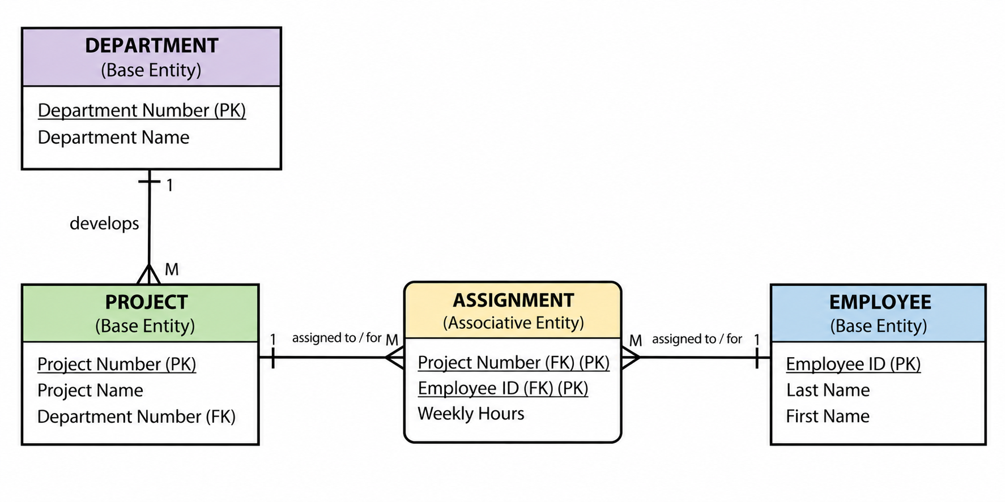
Aurora View 2 — 3NF ERD

Slide 36
Comparing View 1 and View 2
Let's compare the 3NF results from both views:
View 1 Tables | View 2 Tables | Same?
Employee | Employee | Similar — View 1 has Department Number, View 2 doesn't
Department | Department | Same
WorksOn | Assignment | Similar — both are associative entities
Project | Project | Similar — View 1 has Sponsoring Department Name, View 2 has Department Number

Slide 37
Merging Rules
Rule | Explanation
Tables with the same PK can be merged | Combine attributes from both tables into one
All entities must be preserved | Don't lose any tables
All attributes must be preserved | Don't lose any columns
All relationships must be preserved | Don't lose any connections
When merging two or more views→
What to look for:
Scenario | Action
Same table name, same PK | Merge attributes
Same table name, different PK | Keep separate, rename if needed
Different table name, same PK | Merge into one table
Different table name, different PK | Keep separate

Slide 38
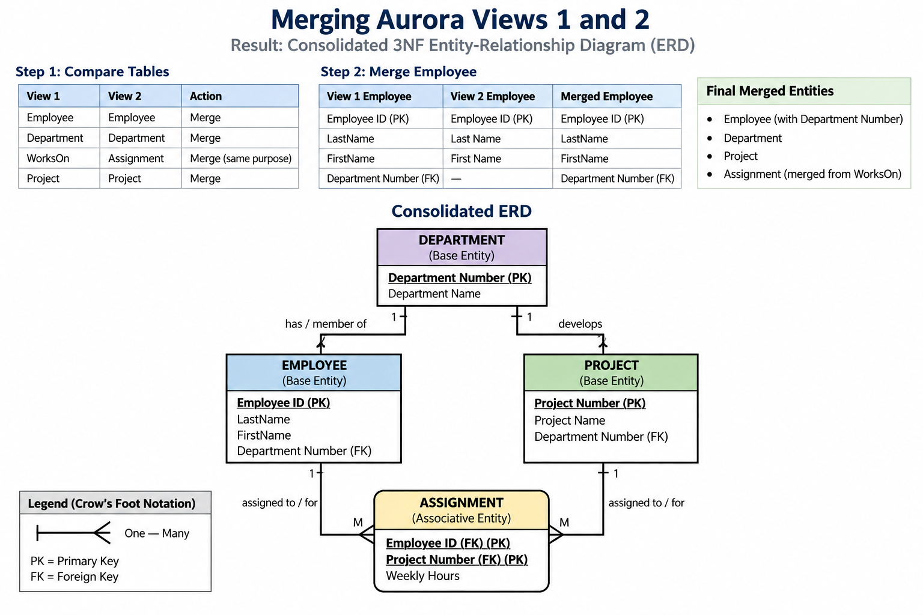
Merging Aurora Views 1 and 2

Slide 39
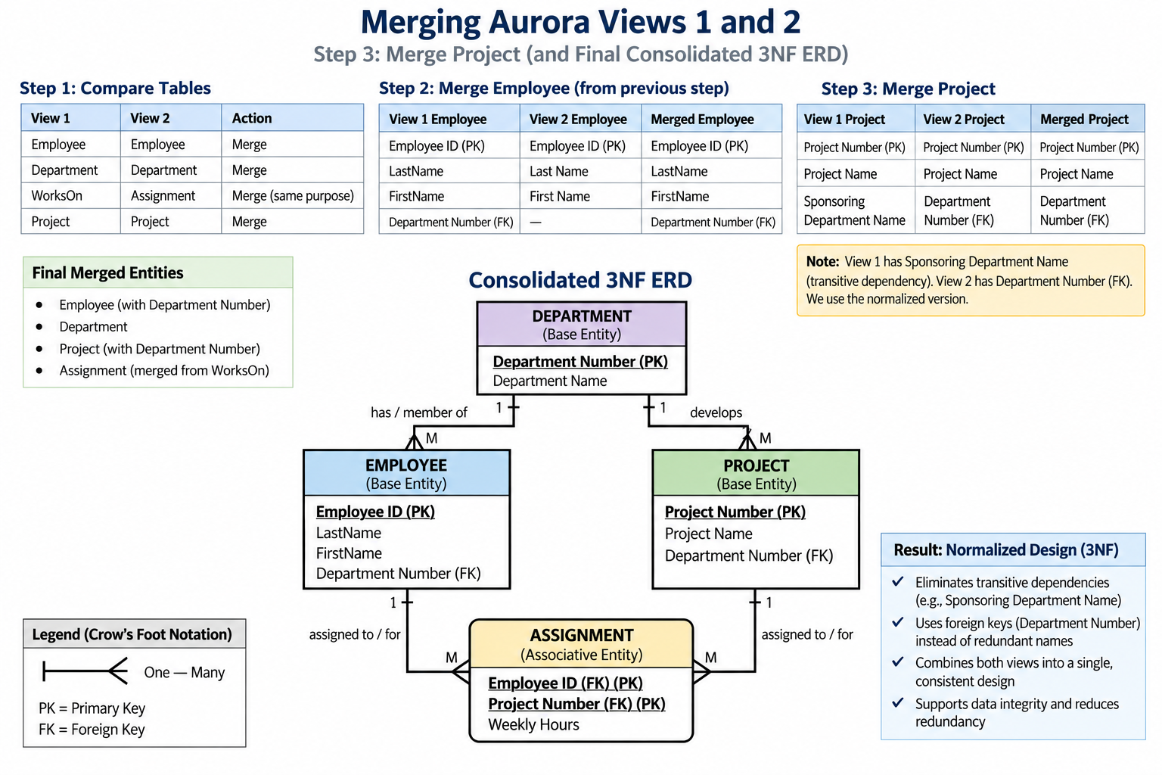
Merging — Project and Assignment

Slide 40
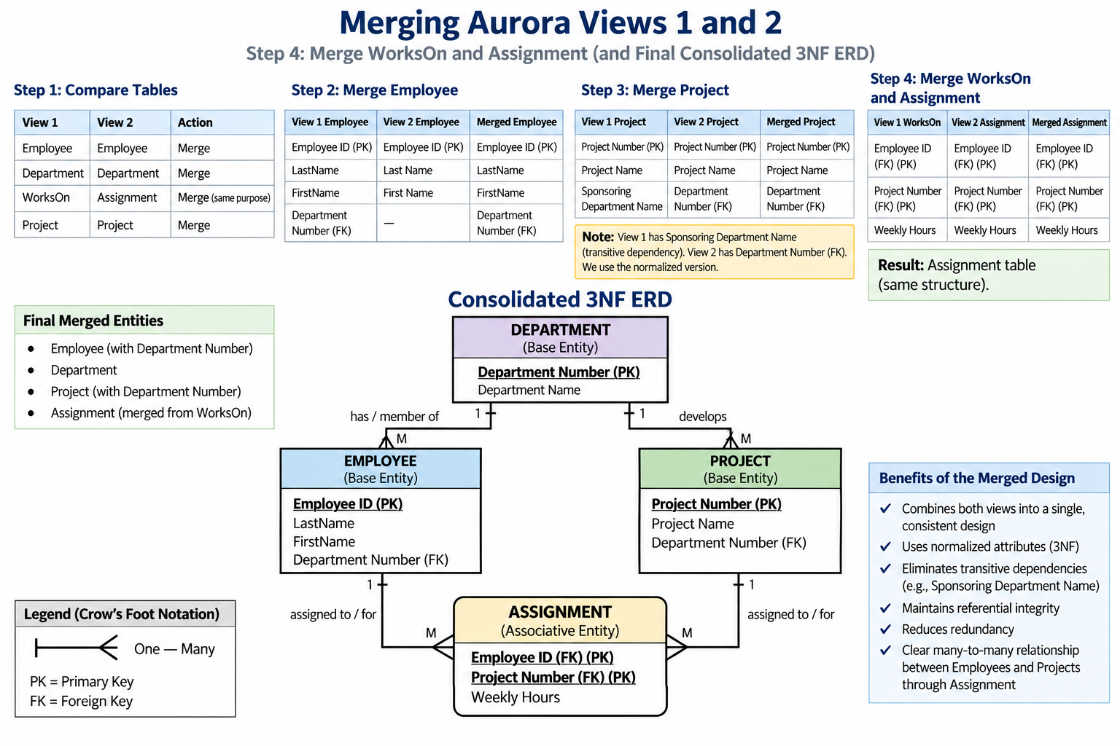
Merging — Project and Assignment

Slide 41
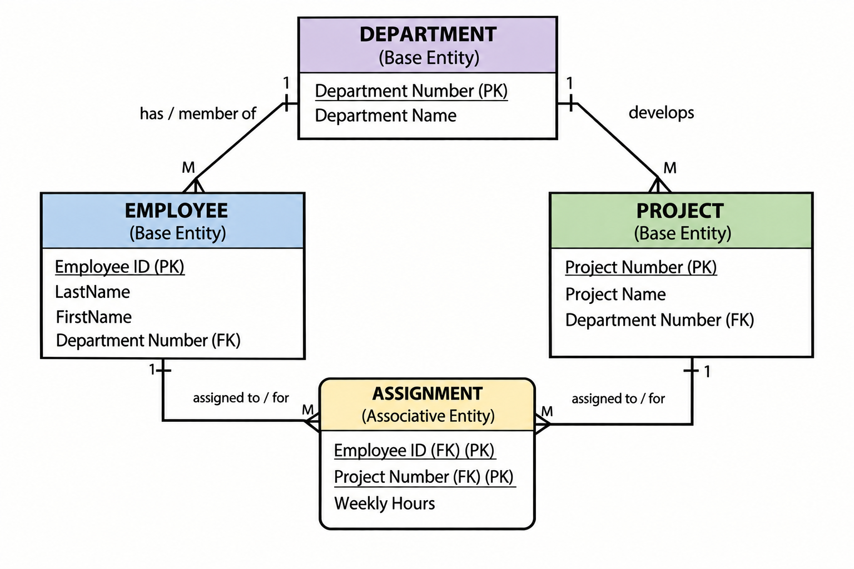
Merging — Project and Assignment

Slide 42
Merging — Project and Assignment

Slide 43
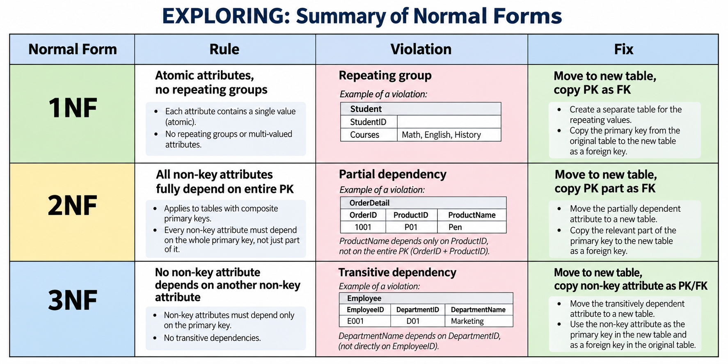
Summary of Normal Forms

